Slide 1
REGRESSION PROJECT
Motor Speed Prediction using Regression Analysis

Slide 2
INTRODUCTION
This project is about training a machine learning model that can predict the speed of a permanent magnet synchronous motor (PMSM) with the help some variables.
The target is to understand the different variables or features given in the data, clean the data, and see which are important in predicting the motor speed.
And the next step is to train different models using these variables and make predictions.
Check which model is giving the best results, that is, the least error between the predictions and the actual values.
The first step is to understand about the problem in detail. Here we should do some theoretical research about the PMSM and different variables mentioned in the dataset.

Slide 3
Part - 1
Theoretical Research

Slide 4
Electric Motor
The electric motor works on the principle of converting the electrical energy into mechanical energy by the application of a magnetic field on a current carrying conductor. The most basic equation of the force applied on a current carrying rod of length 'l' and with current 'i' and a magnetic field 'B' is
F = (i * l) × B
This force will cause the rod to move in the resultant direction. So, in a basic DC motor the current carrying armature when placed in a magnetic field it will cause the armature to rotate because of the magnetic field.
The force mentioned above is directly proportional to the centripetal force of the armature which is given by
F = m * w^2 * r -- w is the angular speed of the motor
So, the angular speed of the motor is directly proportional to the current carried by the wire.

Slide 5
Synchronous Motor
The name synchronous means that the motor will have an angular speed that is constant and is equal to the frequency of the alternating current that is supplied to the motor. The functioning of this motor utilizes both the AC and DC currents. As for any motor, this motor also has a stator and a rotor. Both of them will have some teeth like in a gear wheel but not sharp ones. The windings are set up around each tooth on both the stator and rotor.
The stator is supplied with the 3 phase alternating current and the rotor is given the direct current. The arrangement will be in such a way that there will the an attractive force between the teeth of the rotor and stator and this will cause the rotor to rotate.
These are mostly used as robot arm actuators. These are not suitable for high torque operations.

Slide 6
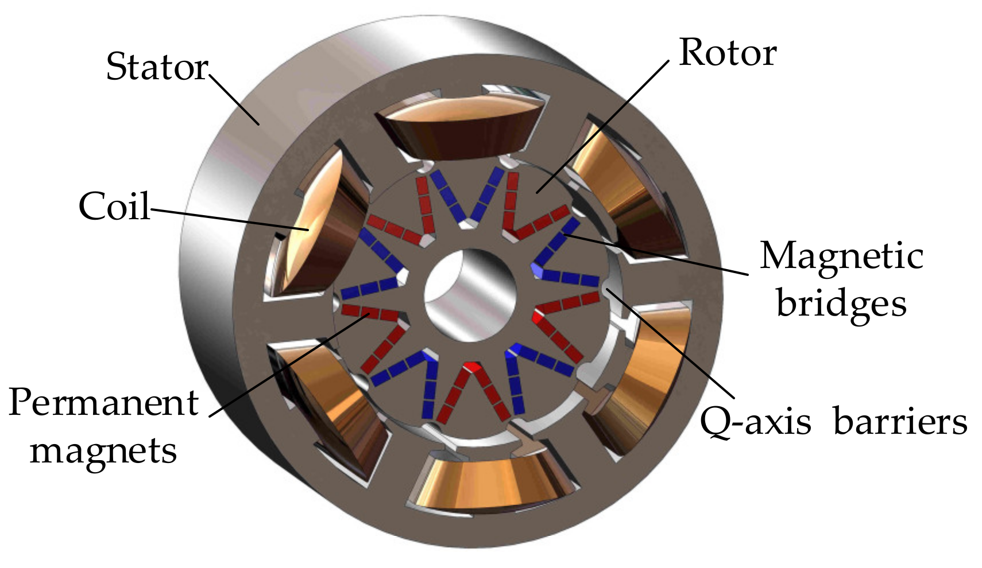
Permanent Magnet Synchronous Motor
This is a synchronous motor that has permanent magnets on the rotor instead of a winding that is supplied with DC. Using a permanent magnet will make it easier to operate and also there will be no heat losses due to the resistance of the rotor winding.
In these motors there will be two components of current and voltage. The D component and the Q component. The D component is in the direction of the magnetic poles of the rotor and the Q component is perpendicular to it. The Q component is responsible for the torque generated.

Slide 7
Part - 2
Exploratory Data Analysis

Slide 8
Understanding the Data
The data collected from the motor contains many variables that includes the ambient and coolant temperatures, the voltages and currents of the D and Q components, the motor's speed and torque, the temperatures of the motor's permanent magnet, the stator's yoke, teeth and windings.
The common reasons for heat generation that causes temperature increase in a basic motor are the heat from resistance of the windings as current passes through it and from the friction between the moving and static components if there is any contact between them. In a PMSM there is no contact between the stator and the rotor. The force is generated by magnetic fields, hence this is no mechanical friction. So, the other heat source will be the resistance heating. This is the heat that is transmitted to different parts of the stator and the rotor.
This heat does not affect the functioning of the motor as long as the heat does not melt the windings. So, theoretically the temperatures will not affect the speed and torque of the motor.
The other data which are the voltages and current will influence the speed and torque. With further data exploration we can find the relationship between different features.

Slide 9
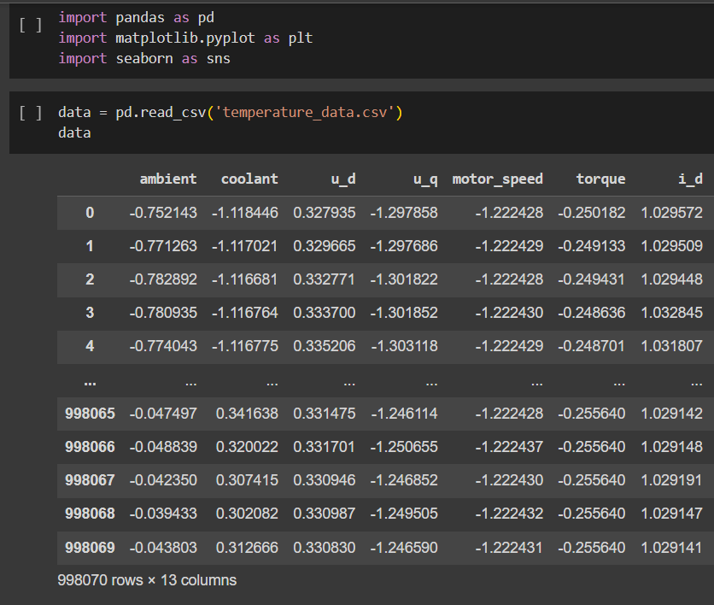
Exploratory Data Analysis - EDA
The next step is to explore the dataset, understand the variables, check for any duplicate observations repeating multiple times, check for outliers in different columns and dealing with them.
After dealing with the outliers the important variables required for motor speed prediction should be identified.
The python libraries needed for these tasks are pandas for data frame operations, numpy for any mathematical operations, and matplotlib and seaborn for making plots of different kinds.
The library imports and the data can be seen here.

Slide 10
Feature Description
ambient - the temperature of the surroundings of the motor
coolant - the temperature of the coolant used in the motor
u_d - the D component of the voltage
u_q - the Q component of the voltage
motor_speed - the speed of the motor
torque - the torque generated in the motor
i_d - the D component of the current
i_q - the Q component of the current
pm - the temperature of the permanent magnet rotor
stator_yoke - the temperature of the stator's yoke which is the main body
stator_tooth - the temperature of the stator's tooth to which the winding is wound
stator_winding - the temperature of the stator's winding that carries the current

Slide 11
The next step is to check for duplicate rows and missing values. This dataset does not have any duplicate rows or missing values.
After that is done, the next step is to check for any errors in the data types of the variables, and the data types of variables in this dataset are accurate.
In the beginning itself we can easily identify and drop some unwanted columns in the dataset. These columns will disturb the analysis of other columns. In this dataset the profile_id is one such column. So it is dropped.
The next step would be to check for correlations between different columns in the dataset. This will give us some idea as to which variables are strongly related to the motor speed.
When the correlations are obtained, the variables u_q and i_d have strong correlation with motor speed and also the variables pm, stator_yoke, stator_tooth, and stator_winding have some high correlations among themselves. This will cause multi-collinearity issues and should be dealt with before model building.
Before proceeding to deal with the multi-collinearity issues, the outliers should be checked and dealt with.

Slide 12
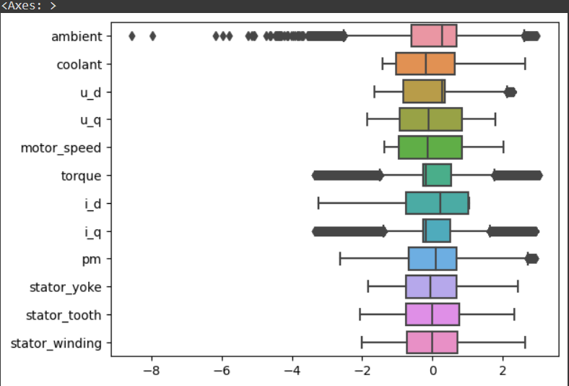
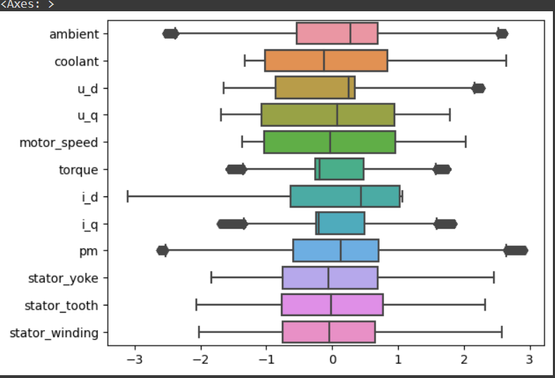
Outlier Detection
The outliers can be detected using the box plots.
In the box plots I found that the ambient, torque, and i_q columns have some very high amount of outliers.
Using the box plots math I calculated the number of outliers in these columns. The number of observations containing these outliers are around 15% of the total data. So, I removed these observations instead of dropping those columns.
The box plot before (top one) and after (bottom one) removing the outliers can be seen here.
After removing these observations the outliers dropped significantly.
Before removing outliers
After removing outliers

Slide 13
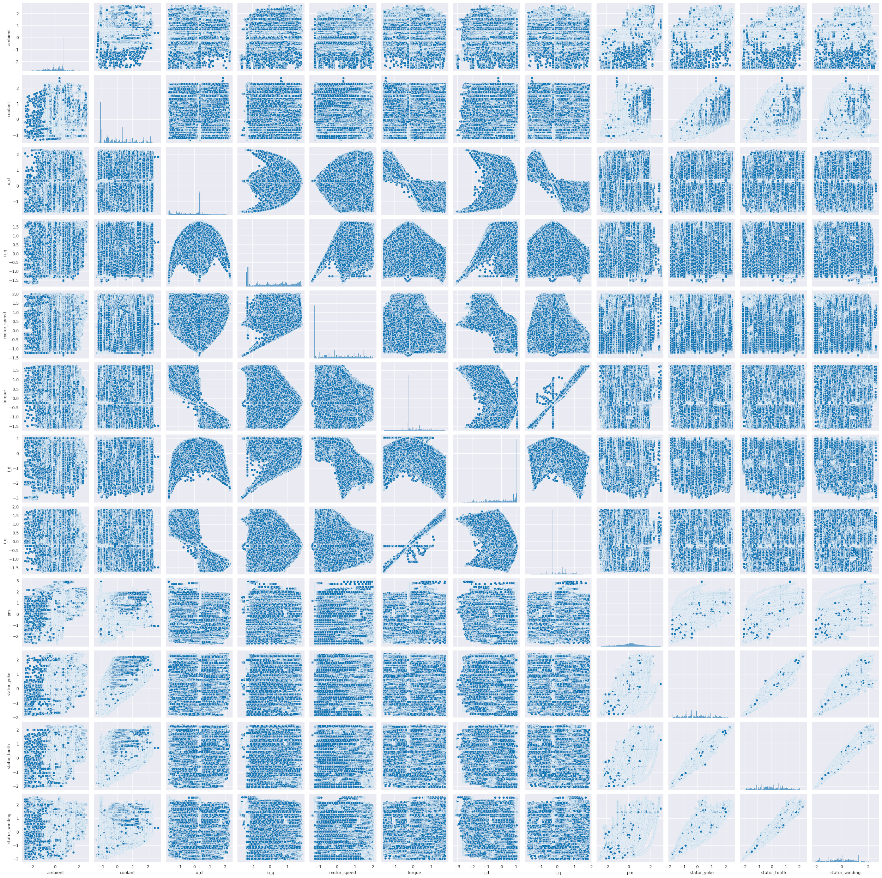
Checking Correlations Again
After removing the outliers we should check the correlations again. These can be checked using the correlation matrix or the pair-plots that contain the scatter plots between all the variable pairs.
The correlation between the motor speed and the u_q, i_q variables have improved after removing outliers.
The pair-plots of all the variable pairs can be seen here.

Slide 14
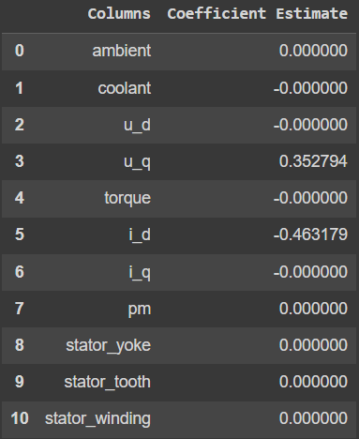
Regularization - Remove unwanted variables and solve multicollinearity
To find out which variables are really important there are two techniques. The first one is the regularization and the next is the VIF scores.
There are 3 regularization techniques which are
Ridge regularization
Lasso regularization
Elastic-Net regularization
Among the 3 regularization techniques the Elastic-Net gave the best results. I found that the variables u_q and i_d are the most important ones that are need to predict the motor speed and the rest can be ignored.
The technique gives a high score in magnitude for the variables that are important and very low scores, sometimes zero, for those that are not needed.
The result is matching with the observations from correlation matrix.

Slide 15
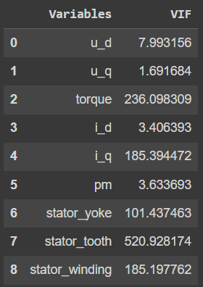
VIF Scores - Remove unwanted variables and solve multi-collinearity
This technique also works in a similar way. The only difference is that the unwanted variables will get a very high VIF score and the needed ones will get very low scores.
I checked with this technique as well because this might give some different results like it might include more variables compared to regularization.
As assumed when the results are found, the variables u_d, u_q, i_d, and pm are important in the prediction of the motor speed. The other variables got very high scores and can be ignored.
With this I prepared two final datasets one with results from regularization and one with results from VIF scores. More can be found out when the models are trained.

Slide 16
Part - 3
Regression Models Training

Slide 17
Different Models Trained
These are the different models that are trained for making predictions.
Equation based models
Multi-linear regression
Polynomial regression – of order 2, 3, ½, and 1/3.
Parameter based models
Decision tree regression
Random forest regression
K Nearest Neighbors regression
Linear Support Vector regression
Bagging ensemble regression
AdaBoost ensemble regression
Gradient Boost regression
Stacking ensemble regression
Artificial Neural Networks

Slide 18
Equation Based Models
Linear regressor
With the independent variables as u_d, u_q, i_d, and pm and the target variable as the motor speed, a linear regression model is built.
The accuracy of the model is 93.9%
Polynomial regressor – 2nd order
The squared values of the most important variables which are u_q and i_d are added to the linear regression equation.
The accuracy of the model is 94.4%
Polynomial regressor – 3rd order
The cube values of the most important variables which are u_q and i_d are added to the linear regression equation.
The accuracy of this model is 96.6%
Polynomial regressor – ½nd order
The square root values of the most important variables which are u_q and i_d are added to the linear regression equation.
The accuracy of the model is 94.4%
Polynomial regressor – 1/3rd order
The cube root values of the most important variables which are u_q and i_d are added to the linear regression equation.
The accuracy of this model is 95.5%

Slide 19
Parameter Based Models and Neural Networks
Decision tree regressor
A Decision tree regressor with a depth of 30.
The accuracy of the model is 99.996%
Random forest regressor
A random forest ensemble with 10 estimators
The accuracy of the model is 99.979%
K Nearest Neighbors regressor
A KNN regressor with 5 neighbors
The accuracy of this model is 99.919%
Linear SVR
A Support Vector Regressor with a Linear kernel.
The accuracy of the model is 93.805%
Bagging ensemble regressor
A bagging ensemble with 10 decision tree estimators with a depth of 30.
The accuracy of this model is 99.979%
AdaBoost ensemble regressor
An AdaBoost ensemble with 10 decision tree estimators with a depth of 30.
The accuracy of this model is 99.999%
…..

Slide 20
Parameter Based Models and Neural Networks
…..
Gradient Boosting regressor
A Gradient boost regressor with decision tree estimators.
The accuracy of this model is 99.452%
Stacking ensemble regressor
The Elastic-Net, Decision tree with depth 30, and the Gradient boosting regressors stacked together.
The accuracy of this model is 99.830%
Artificial Neural Networks
An ANN with 3 hidden layers, a learning rate of 0.001, a drop rate of 0, and Adam optimizer.
The accuracy of this model is 99.599%

Slide 21
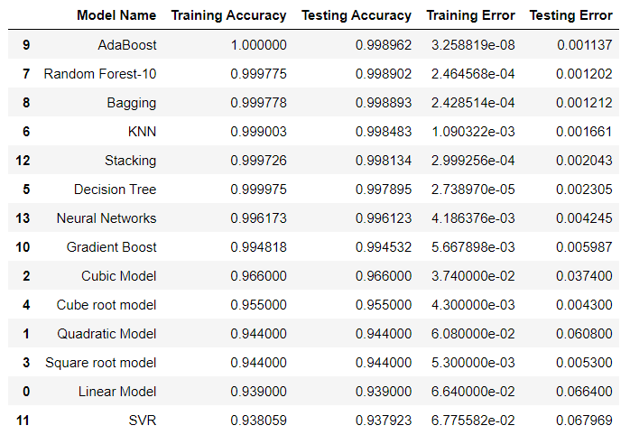
Accuracies and Errors of all models
These are the accuracies and errors of the training and the testing sets.
The AdaBoost regressor has the highest training and testing accuracy and least errors which makes it the best model for predicting the motor speed.
With these trained models the next step would be to deploy the machine learning model for live predictions.

Slide 22
Part - 4
Deployment

Slide 23
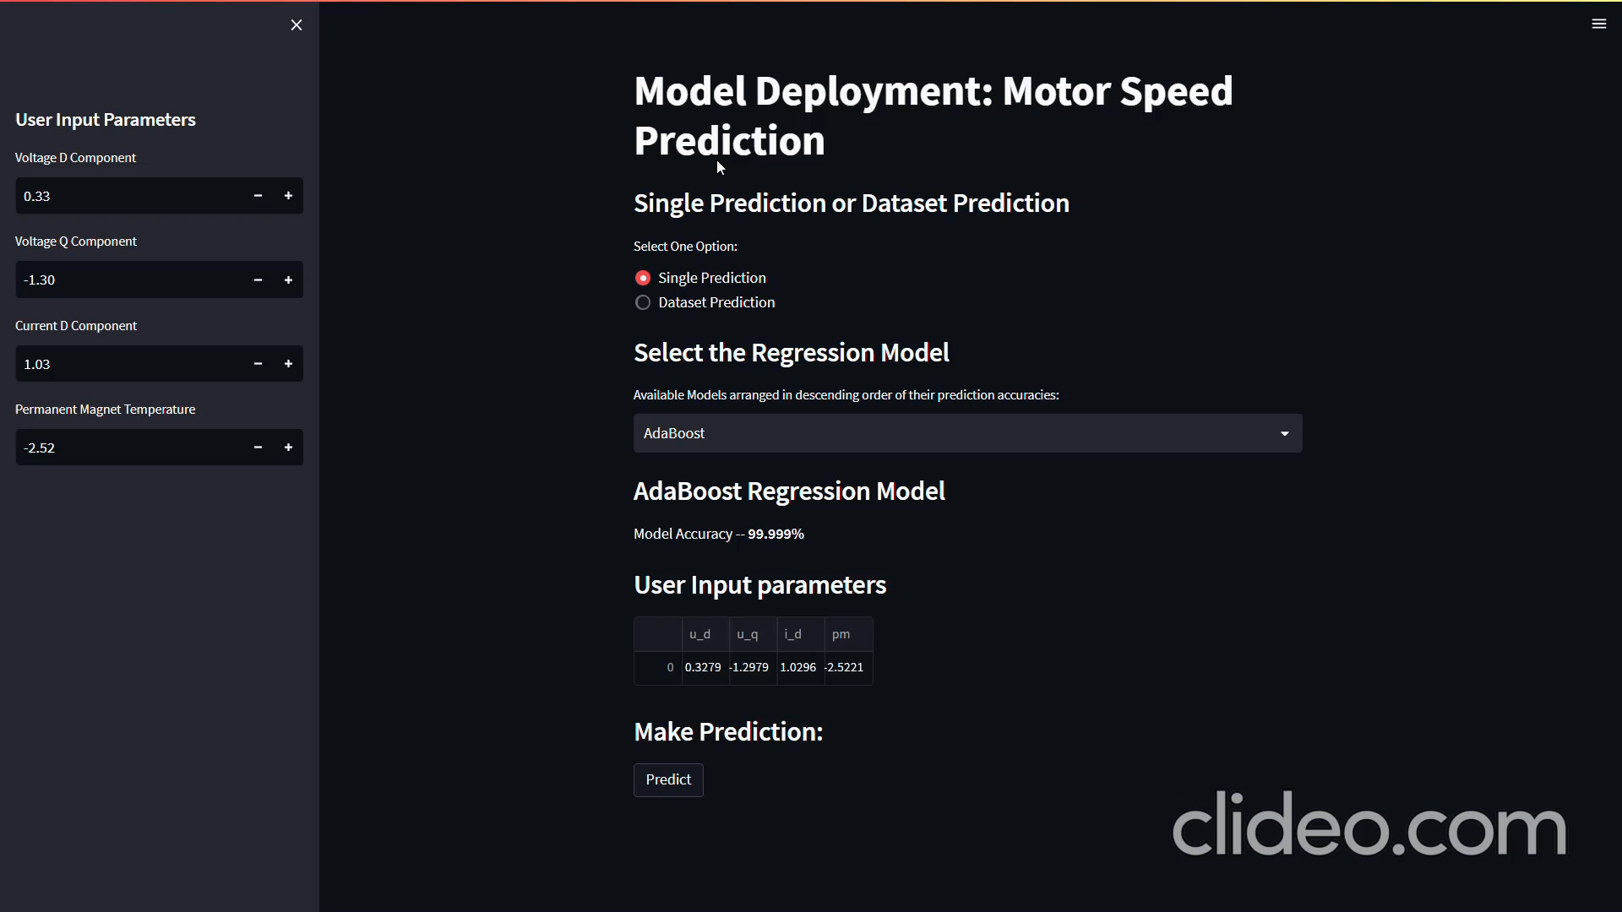
Deployment
The final step is the deployment of the trained models for making live predictions.
The live prediction site has the options to make a prediction for a single observation and also for the entire dataset. The user can choose one.
The user can also choose between the different regressors mentioned previously. The accuracies of all the models can be seen there.
For the single predictions the user can enter the four variable values which are the u_d, u_q, i_d, and pm and make the prediction with the selected regressor.
For a dataset prediction, the user shall upload the dataset and make the predictions for the entire dataset, and finally download the predictions dataset.
The overall functioning of the deployed site can be seen in the video.
Play the video to watch the live model

Slide 24
Thank you

